Slide 1
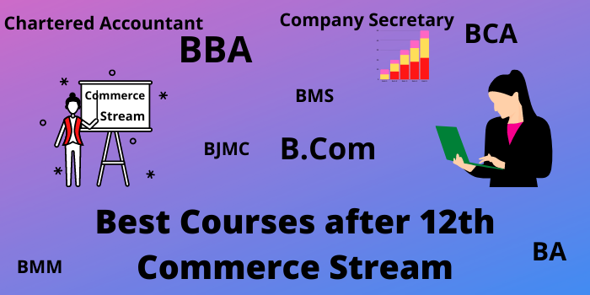

+ 2 Commerce
One Mark Test

Slide 2

Prepared by ….
M.MuthuSelvam
M.Sc.,M.Com.M.Ed.,M.Phil.
PG Asst. in Commerce
MLWA HSS
(Run by Jain Educational & Empowerment Trust)
Madurai 625 001
Cell No: 98421 04826

Slide 3
Management is what a _______ does?
Superior
Subordinate
Manager
Supervisor

Slide 4
WRONG CLICK

Slide 5

Good
Try Next One

Slide 6

Wrong
Try Again

Slide 7
Management is an ________
Science
Art
Art and Science
Art or Science

Slide 8
WRONG CLICK

Slide 9
Good
Try Next One

Slide 10
Wrong
Try Again

Slide 11
Scientific management is developed by
Fayol
Taylor
Mayo
Jacob

Slide 12
WRONG CLICK

Slide 13
Good
Try Next One

Slide 14
Wrong
Try Again

Slide 15
Dividing the work into small tasks is known as
Discipline
Unity
Division of work
Equity

Slide 16
WRONG CLICK

Slide 17
Good
Try Next One

Slide 18
Wrong
Try Again

Slide 19
With a wider span, there will be ___hierarchical levels.
More
Less
Multiple
Additional

Slide 20
WRONG CLICK

Slide 21
Good
Try Next One

Slide 22
Wrong
Try Again

Slide 23
Which is the primary function of management?
Innovating
Controlling
Planning
Decision-making

Slide 24
WRONG CLICK

Slide 25
Good
Try Next One

Slide 26
Wrong
Try Again

Slide 27
Which of the following is not a main function?
Decision-making
Planning
Organising
Staffing

Slide 28
WRONG CLICK

Slide 29
Good
Try Next One

Slide 30
Wrong
Try Again

Slide 31
_______ is included in every managerial function.
Controlling
Co-ordinating
Organising
Staffing

Slide 32
WRONG CLICK

Slide 33
Good
Try Next One

Slide 34
Wrong
Try Again

Slide 35
Which of the following is verification function?
Organising
Planning
Staffing
Controlling

Slide 36
WRONG CLICK

Slide 37
Good
Try Next One

Slide 38
Wrong
Try Next One

Slide 39
The goals are achieved with the help of ____
Motivation
Controlling
Planning
Staffing

Slide 40
WRONG CLICK

Slide 41
Good
Try Again

Slide 42
Wrong
Try Again

Slide 43
___________ System gives full Scope to theIndividual Strength and Responsibility.
MBO
MBE
MBM
MBA

Slide 44
WRONG CLICK

Slide 45
Good
Try Next One

Slide 46
Wrong
Try Again

Slide 47
Which is the First step in Process of MBO ?
Fixing Key Result Area
Appraisal of Activities
Matching Resources with Activities
Defining Organisational Objectives

Slide 48
WRONG CLICK

Slide 49
Good
Try Next One

Slide 50
Wrong
Try Again

Slide 51
__________ keeps Management Alert to Opportunities and Threats by Identifying Critical Problems.
MBA
MBE
MBM
MBO

Slide 52
WRONG CLICK

Slide 53
Good
Try Next One

Slide 54
Wrong
Try Next One

Slide 55
Delegation of Authority is Easily Done with the Help of ______.
MBM
MBE
MBO
MBA

Slide 56
WRONG CLICK

Slide 57
Good
Try Next One

Slide 58
Wrong
Try Again

Slide 59
MBO is popularised in the USA by ________
George Odiorne
Prof. Reddin
Henry Fayol
F.W Taylor

Slide 60
WRONG CLICK

Slide 61
Good
Try Next One

Slide 62
Wrong
Try Again

Slide 63
Financial market facilitates business firms
To recruit workers
To rise funds
To make more sales
To minimize fund requirement

Slide 64
WRONG CLICK

Slide 65
Good
Try Next One

Slide 66
Wrong
Try Again

Slide 67
Capital market is a market for
Short Term Finance
Medium Term Finance
Long Term Finance
Both Short Term and Medium Term Finance

Slide 68
WRONG CLICK

Slide 69
Good
Try Next One

Slide 70
Wrong
Try Again

Slide 71
Primary market is also called as
Secondary market
Money market
New Issue Market
Indirect Market

Slide 72
WRONG CLICK

Slide 73
Good
Try Next One

Slide 74
Wrong
Try Again

Slide 75
Spot Market is a market where the delivery of the financial instrument and payment of cash occurs
In the future
Immediately
Uncertain
After one month

Slide 76
WRONG CLICK

Slide 77
Good
Try Next One

Slide 78
Wrong
Try Again

Slide 79
How many times a security can be sold in a secondary market?
Only one time
Two time
Three times
Multiple times

Slide 80
WRONG CLICK

Slide 81
Good
Try Next One

Slide 82
Wrong
Try Again

Slide 83
Capital market do not provide
Debenture Funds
Short term Funds
Equity Funds
Long term Funds

Slide 84
WRONG CLICK

Slide 85
Good
Try Next One

Slide 86
Wrong
Try Again

Slide 87
When the NSEI was established
1990
1992
1998
1997

Slide 88
WRONG CLICK

Slide 89
Good
Try Next One

Slide 90
Wrong
Try Again

Slide 91
Primary market is a Market where securities are traded in the
First Time
Second Time
Three Time
Several Times

Slide 92
WRONG CLICK

Slide 93
Good
Try Next One

Slide 94
Wrong
Try Again

Slide 95
Participants in the Capital Market includes
Individuals
Corporate
All of the above
Financial Institutions

Slide 96
WRONG CLICK

Slide 97
Good
Try Next One

Slide 98
Wrong
Try Again

Slide 99
The _______ was set up by a premier financial institution to allow the trading of securities across the electronic counters
throughout the country.
OTCEI
Factoring
Mutual Funds
Venture Funds
Institutions

Slide 100
WRONG CLICK

Slide 101
Good
Try Next One

Slide 102
Wrong
Try Again

Slide 103
The money invested in the call money market provides high liquidity with _________
High Profitability
Limited Profitability
Low Profitability
Medium Profitability

Slide 104
WRONG CLICK

Slide 105
Good
Try Next One

Slide 106
Wrong
Try Again

Slide 107
A major player in the money market is the ____
Commercial Bank
Reserve Bank of India
State Bank of India
Central Bank

Slide 108
WRONG CLICK

Slide 109
Good
Try Next One

Slide 110
Wrong
Try Again

Slide 111
Debt Instruments are issued by Corporate Houses are raising short-term financial resources from the money market are called ______
Treasury Bills
Commercial Paper
Government Securities
Certificate of Deposit

Slide 112
WRONG CLICK

Slide 113
Good
Try Next One

Slide 114
Wrong
Try Again

Slide 115
The market for buying and selling of Commercial Bills of Exchange is known as a _____
Commercial Paper Market
Treasury Bill Market
Commercial Bill Market
Capital Market

Slide 116
WRONG CLICK

Slide 117
Good
Try Next One

Slide 118
Wrong
Try Again

Slide 119
A marketable document of title to a time deposit for a specified period may be referred to as a _______
Treasury Bill
Certificate of Deposit
Commercial Bill
Government. Securities

Slide 120
WRONG CLICK

Slide 121
Good
Try Next One

Slide 122
Wrong
Try Again

Slide 123
____ is the oldest stock exchange in the world.
Bombay Stock Exchange
London Stock Exchange
Amsterdam Stock Exchange
National Stock Exchange

Slide 124
WRONG CLICK

Slide 125
Good
Try Next One

Slide 126
Wrong
Try Again

Slide 127
There are _____ stock exchange in the country.
21
24
20
25

Slide 128
WRONG CLICK

Slide 129
Good
Try Next One

Slide 130
Wrong
Try Again

Slide 131
Jobbers transact in a stock exchange
For their Own Transactions
For their Clients
For other Brokers
For other Members

Slide 132
WRONG CLICK

Slide 133
Good
Try Next One

Slide 134
Wrong
Try Again

Slide 135
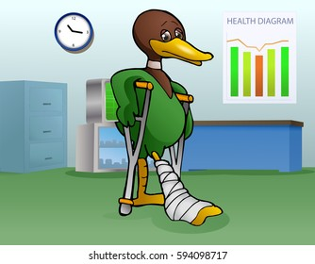

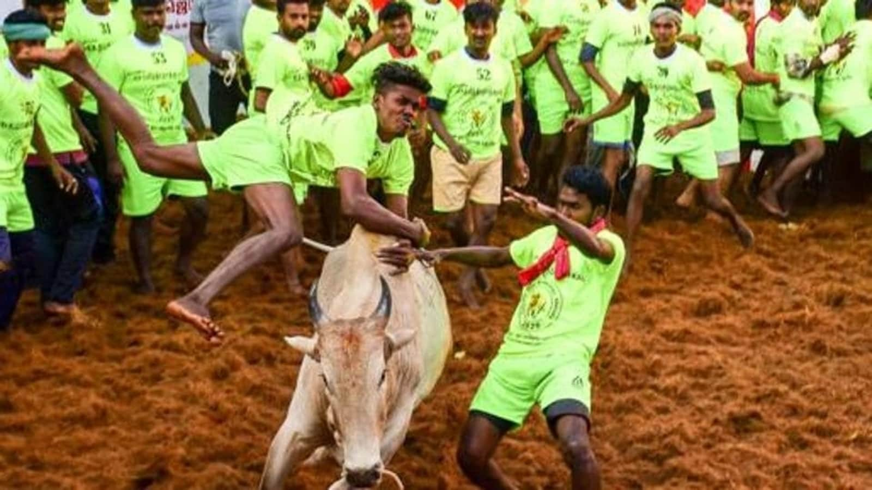
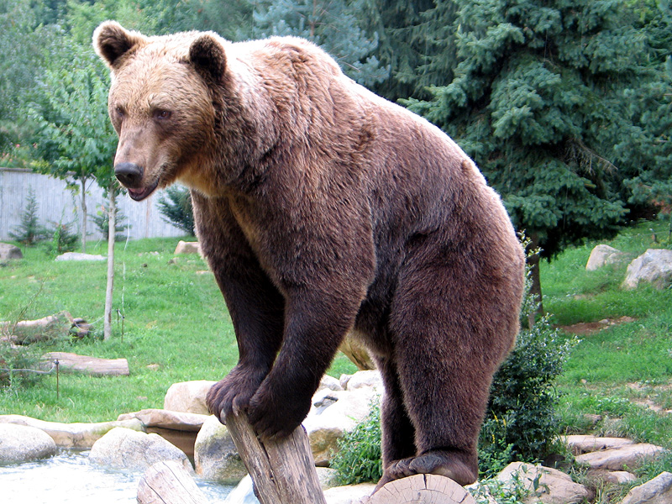
A pessimistic speculator is

Slide 136
WRONG CLICK

Slide 137
Good
Try Next One

Slide 138
Wrong
Try Again

Slide 139
An optimistic speculator is

Slide 140
WRONG CLICK

Slide 141
Good
Try Next One

Slide 142
Wrong
Try Again

Slide 143
Securities Exchange Board of India was first established in the year ____
1988
1992
1995
1998

Slide 144
WRONG CLICK

Slide 145
Good
Try Next One

Slide 146
Wrong
Try Again

Slide 147
The headquarters of SEBI is _______
Calcutta
Bombay
Chennai
Delhi

Slide 148
WRONG CLICK

Slide 149
Good
Try Next One

Slide 150
Wrong
Try Again

Slide 151
Registering and controlling the functioning of collective investment schemes as _______
Listing
Mutual Funds
Rematerialisation
Dematerialization

Slide 152
WRONG CLICK

Slide 153
Good
Try Next One

Slide 154
Wrong
Try Again

Slide 155
SEBI is empowered by the Finance ministry to nominate ______ members on the Governing body of every stock
exchange.
5
7
6
3

Slide 156
WRONG CLICK

Slide 157
Good
Try Next One

Slide 158
Wrong
Try Again

Slide 159
Trading is dematerialized shares commenced on the NSE is ________
January 1996
June 1998
December 1996
December 1998

Slide 160
WRONG CLICK

Slide 161
Good
Try Next One

Slide 162
Wrong
Try Again

Slide 163
Human resource is a _________ asset.
Tangible
Intangible
Fixed
Current

Slide 164
WRONG CLICK

Slide 165
Good
Try Next One

Slide 166
Wrong
Try Again

Slide 167
Human Resource management is both_____ and ____
Science and art
Theory and practice
History and Geography
None of the above

Slide 168
WRONG CLICK

Slide 169
Good
Try Next One

Slide 170
Wrong
Try Again

Slide 171
Planning is a _________ function.
selective
pervasive
none of the above
both selective
and pervasive

Slide 172
WRONG CLICK

Slide 173
Good
Try Next One

Slide 174
Wrong
Try Again

Slide 175
Human resource management determines the __ relationship.
internal, external
employer, employee
Owner, Servant
Principle, Agent

Slide 176
WRONG CLICK

Slide 177
Good
Try Next One

Slide 178
Wrong
Try Again

Slide 179
Labour turnover is the rate at which employees _________ the organisation
enter
leave
Salary
None of the above

Slide 180
WRONG CLICK

Slide 181
Good
Try Next One

Slide 182
Wrong
Try Again

Slide 183
Recruitment is the process of identifying ___.
right man for right job
good performer
Right job
All of the above

Slide 184
WRONG CLICK

Slide 185
Good
Try Next One

Slide 186
Wrong
Try Again

Slide 187
Recruitment bridges gap between ____ and _____ .
job seeker and job provider
job seeker and agent
job provider and owner
owner and servant

Slide 188
WRONG CLICK

Slide 189
Good
Try Next One

Slide 190
Wrong
Try Again

Slide 191
Advertisement is a ________ source of recruitment
external
internal
agent
outsourcing

Slide 192
WRONG CLICK

Slide 193
Good
Try Next One

Slide 194
Wrong
Try Again

Slide 195
Transfer is an ________ source of recruitment.
internal
external
outsourcing
None of the above

Slide 196
WRONG CLICK

Slide 197
Good
Try Next One

Slide 198
Wrong
Try Again

Slide 199
E-recruitment is possible only through ______ facility.
Broadband
Computer
internet
4 G

Slide 200
WRONG CLICK

Slide 201
Good
Try Next One

Slide 202
Wrong
Try Again

Slide 203
The recruitment and Selection Process aimed at right kind of people.
At right people
At right time
To do right things
All of the above

Slide 204
WRONG CLICK

Slide 205
Good
Try Next One

Slide 206
Wrong
Try Again

Slide 207
Selection is usually considered as a _____ process
Positive
Negative
Natural
None of these

Slide 208
WRONG CLICK

Slide 209
Good
Try Next One

Slide 210
Wrong
Try Again

Slide 211
Which of the following test is used to measure the various characteristics of the candidate?
Physical Test
Psychological Test
Attitude Test
Proficiency tests

Slide 212
WRONG CLICK

Slide 213
Good
Try Next One

Slide 214
Wrong
Try Again

Slide 215
The process of eliminating unsuitable candidate is called
Selection
Recruitment
Interview
Induction

Slide 216
WRONG CLICK

Slide 217
Good
Try Next One

Slide 218
Wrong
Try Again

Slide 219
Job first man next is one of the principles of ____
Test
Interview
Training
placement

Slide 220
WRONG CLICK

Slide 221
Good
Try Next One

Slide 222
Wrong
Try Again

Slide 223
Off the Job training is given
In the class room
Outside the factory
In the playground
On off days

Slide 224
WRONG CLICK

Slide 225
Good
Try Next One

Slide 226
Wrong
Try Again

Slide 227
When trainees are trained by supervisor or by superior at the job is called
Refresher training
Role play
Vestibule training
Apprenticeship training

Slide 228
WRONG CLICK

Slide 229
Good
Try Next One

Slide 230
Wrong
Try Again

Slide 231
________ is useful to prevent skill obsolescence of employees
Job analysis
Training
Selection
Recruitment

Slide 232
WRONG CLICK

Slide 233
Good
Try Next One

Slide 234
Wrong
Try Again

Slide 235
Training methods can be classified into ______ and ______ training.
Job rotation and Job enrichment
On the Job and Off the Job
Job analysis and Job design
Physical and mental

Slide 236
WRONG CLICK

Slide 237
Good
Try Next One

Slide 238
Wrong
Try Again

Slide 239
Improves Skill Levels of employees to ensure better job performance
Training
Selection
Recruitment
Performance appraisal

Slide 240
WRONG CLICK

Slide 241
Good
Try Next One

Slide 242
Wrong
Try Again

Slide 243
One who promotes (or) Exchange of goods or services for money is called as
Seller
Marketer
Customer
Manager

Slide 244
WRONG CLICK

Slide 245
Good
Try Next One

Slide 246
Wrong
Try Again

Slide 247
The marketer initially wants to know in the marketing is .
Qualification of the customer
Quality of the product
Background of the customers
Needs of the customers

Slide 248
WRONG CLICK

Slide 249
Good
Try Next One

Slide 250
Wrong
Try Again

Slide 251
The Spot market is classified on the basis of
Commodity
Transaction
Regulation
Time

Slide 252
WRONG CLICK

Slide 253
Good
Try Next One

Slide 254
Wrong
Try Again

Slide 255
Which one of the market deals in the purchase and sale of shares and debentures?
Stock Exchange Market
Manufactured Goods Market
Local Market
Family Market

Slide 256
WRONG CLICK

Slide 257
Good
Try Next One

Slide 258
Wrong
Try Again

Slide 259
Stock Exchange Market is also called ________
Spot Market
Local Market
Security Market
National Market

Slide 260
WRONG CLICK

Slide 261
Good
Try Next One

Slide 262
Wrong
Try Again

Slide 263
The initial stage of Marketing system is ____
Monopoly system
Exchange to Money
Barter system
Self producing

Slide 264
WRONG CLICK

Slide 265
Good
Try Next One

Slide 266
Wrong
Try Again

Slide 267
Who is supreme in the Market?
Customer
Seller
Wholesaler
Retailer

Slide 268
WRONG CLICK

Slide 269
Good
Try Next One

Slide 270
Wrong
Try Again

Slide 271
In the following variables which one is not the variable of marketing mix?
Product Variable
Place Variable
Program Variable
Price Variable

Slide 272
WRONG CLICK

Slide 273
Good
Try Next One

Slide 274
Wrong
Try Again

Slide 275
Marketing mix means a marketing program that is offered by a firm to its target ______________ to earn profits through satisfaction of their wants.
Retailer
Wholesaler
Consumer
Seller

Slide 276
WRONG CLICK

Slide 277
Good
Try Next One

Slide 278
Wrong
Try Again

Slide 279
Which one is the example of Intangible product ?
Education
Mobiles
Garments
Vehicles

Slide 280
WRONG CLICK

Slide 281
Good
Try Next One

Slide 282
Wrong
Try Again

Slide 283
Selling goods/ services through internet is
Green marketing
E- business
Meta marketing
Social marketing

Slide 284
WRONG CLICK

Slide 285
Good
Try Next One

Slide 286
Wrong
Try Again

Slide 287
Which is gateway to internet?
Portal
CPU
Modem
Webnaire

Slide 288
WRONG CLICK

Slide 289
Good
Try Next One

Slide 290
Wrong
Try Again

Slide 291
Social marketing deals with:
Social Class
Society
Social change
Social evil

Slide 292
WRONG CLICK

Slide 293
Good
Try Next One

Slide 294
Wrong
Try Again

Slide 295
Effective use of Social media marketing increase conversion rates of _________
Customer to buyers
Retailer to customers
One buyer to another buyer’s
Direct contact of marketer

Slide 296
WRONG CLICK

Slide 297
Good
Try Next One

Slide 298
Wrong
Try Again

Slide 299
Pure play retailers are called
Market creators
Transaction brokers
Merchants
Agents

Slide 300
WRONG CLICK

Slide 301
Good
Try Next One

Slide 302
Wrong
Try Again

Slide 303
The term ‘consumerism’ came intoexistence in the year ____
1957
1960
1954
1958

Slide 304
WRONG CLICK

Slide 305
Good
Try Next One

Slide 306
Wrong
Try Again

Slide 307
Who is the father of Consumer Movement?
Mahatma Gandhi
Mr. Jhon F. Kennedy
Ralph Nader
Jawaharlal Nehru

Slide 308
WRONG CLICK

Slide 309
Good
Try Next One
Good
Try Next One

Slide 310
Wrong
Try Again

Slide 311
Sale of Goods Act was passed in the year?
1972
1962
1930
1985

Slide 312
WRONG CLICK

Slide 313
Good
Try Next One

Slide 314
Wrong
Try Again

Slide 315
The Consumer Protection Act came into force with effect from
01. 04. 1986
01. 01. 1986
15. 04. 1987
15. 04. 1990

Slide 316
WRONG CLICK

Slide 317
Good
Try Next One

Slide 318
Wrong
Try Again

Slide 319
_____ of every year is declared as a Consumer Protection Day to educate the public about their rights and responsibilities.
August 15
April 15
March 15
September 15

Slide 320
WRONG CLICK

Slide 321
Good
Try Next One

Slide 322
Wrong
Try Again

Slide 323
The final aim of modern marketing is ____
Minimum profit
Maximum profit
Service to the society
Consumer satisfaction

Slide 324
WRONG CLICK

Slide 325
Good
Try Next One

Slide 326
Wrong
Try Again

Slide 327
_______ is the king of modern marketing.
Consumer
Wholesaler
Producer
Reatailer

Slide 328
WRONG CLICK

Slide 329
Good
Try Next One

Slide 330
Wrong
Try Again

Slide 331
As the consumer is having the rights, they are also having ____
Promotion
Measures
Responsibilities
Duties

Slide 332
WRONG CLICK

Slide 333
Good
Try Next One

Slide 334
Wrong
Try Again

Slide 335
Which of the following is not a consumer right summed up by John F. Kennedy
Right to choose
Right to safety
Right to consume
Right to be informed

Slide 336
WRONG CLICK

Slide 337
Good
Try Next One

Slide 338
Wrong
Try Again

Slide 339
It is the responsibility of a consumer that he must obtai______ as a proof for the purchase of goods.
Cash receipt
Warranty card
Invoice
All of these

Slide 340
WRONG CLICK

Slide 341
Good
Try Next One

Slide 342
Wrong
Try Again

Slide 343

Greetings to get More Marks
in Quarterly Exam

