Slide 1
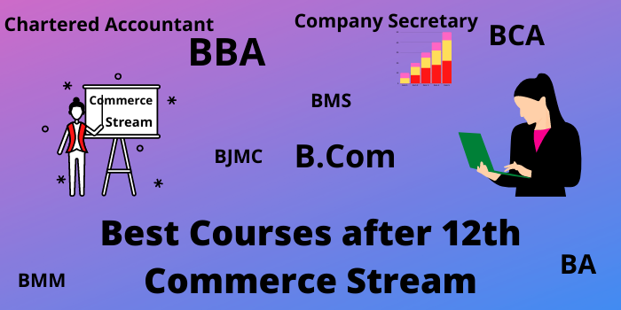

+ 2 Commerce
One Mark Test

Slide 2

Prepared by ….
M.MuthuSelvam
M.Sc.,M.Com.M.Ed.,M.Phil.
PG Asst. in Commerce
MLWA HSS
(Run by Jain Educational & Empowerment Trust)
Madurai 625 001
Cell No: 98421 04826

Slide 3
Management is what a _______ does?
Superior
Subordinate
Manager
Supervisor

Slide 4
WRONG CLICK

Slide 5

Good
Try Next One

Slide 6

Wrong
Try Again

Slide 7
Management is an ________
Science
Art
Art and Science
Art or Science

Slide 8
WRONG CLICK

Slide 9
Good
Try Next One

Slide 10
Wrong
Try Again

Slide 11
Scientific management is developed by
Fayol
Taylor
Mayo
Jacob

Slide 12
WRONG CLICK

Slide 13
Good
Try Next One

Slide 14
Wrong
Try Again

Slide 15
Dividing the work into small tasks is known as
Discipline
Unity
Division of work
Equity

Slide 16
WRONG CLICK

Slide 17
Good
Try Next One

Slide 18
Wrong
Try Again

Slide 19
With a wider span, there will be ___hierarchical levels.
More
Less
Multiple
Additional

Slide 20
WRONG CLICK

Slide 21
Good
Try Next One

Slide 22
Wrong
Try Again

Slide 23
Which is the primary function of management?
Innovating
Controlling
Planning
Decision-making

Slide 24
WRONG CLICK

Slide 25
Good
Try Next One

Slide 26
Wrong
Try Again

Slide 27
Which of the following is not a main function?
Decision-making
Planning
Organising
Staffing

Slide 28
WRONG CLICK

Slide 29
Good
Try Next One

Slide 30
Wrong
Try Again

Slide 31
_______ is included in every managerial function.
Controlling
Co-ordinating
Organising
Staffing

Slide 32
WRONG CLICK

Slide 33
Good
Try Next One

Slide 34
Wrong
Try Again

Slide 35
Which of the following is verification function?
Organising
Planning
Staffing
Controlling

Slide 36
WRONG CLICK

Slide 37
Good
Try Next One

Slide 38
Wrong
Try Next One

Slide 39
The goals are achieved with the help of ____
Motivation
Controlling
Planning
Staffing

Slide 40
WRONG CLICK

Slide 41
Good
Try Again

Slide 42
Wrong
Try Again

Slide 43
___________ System gives full Scope to theIndividual Strength and Responsibility.
MBO
MBE
MBM
MBA

Slide 44
WRONG CLICK

Slide 45
Good
Try Next One

Slide 46
Wrong
Try Again

Slide 47
Which is the First step in Process of MBO ?
Fixing Key Result Area
Appraisal of Activities
Matching Resources with Activities
Defining Organisational Objectives

Slide 48
WRONG CLICK

Slide 49
Good
Try Next One

Slide 50
Wrong
Try Again

Slide 51
__________ keeps Management Alert to Opportunities and Threats by Identifying Critical Problems.
MBA
MBE
MBM
MBO

Slide 52
WRONG CLICK

Slide 53
Good
Try Next One

Slide 54
Wrong
Try Next One

Slide 55
Delegation of Authority is Easily Done with the Help of ______.
MBM
MBE
MBO
MBA

Slide 56
WRONG CLICK

Slide 57
Good
Try Next One

Slide 58
Wrong
Try Again

Slide 59
MBO is popularised in the USA by ________
George Odiorne
Prof. Reddin
Henry Fayol
F.W Taylor

Slide 60
WRONG CLICK

Slide 61
Good
Try Next One

Slide 62
Wrong
Try Again

Slide 63
Financial market facilitates business firms
To recruit workers
To rise funds
To make more sales
To minimize fund requirement

Slide 64
WRONG CLICK

Slide 65
Good
Try Next One

Slide 66
Wrong
Try Again

Slide 67
Capital market is a market for
Short Term Finance
Medium Term Finance
Long Term Finance
Both Short Term and Medium Term Finance

Slide 68
WRONG CLICK

Slide 69
Good
Try Next One

Slide 70
Wrong
Try Again

Slide 71
Primary market is also called as
Secondary market
Money market
New Issue Market
Indirect Market

Slide 72
WRONG CLICK

Slide 73
Good
Try Next One

Slide 74
Wrong
Try Again

Slide 75
Spot Market is a market where the delivery of the financial instrument and payment of cash occurs
In the future
Immediately
Uncertain
After one month

Slide 76
WRONG CLICK

Slide 77
Good
Try Next One

Slide 78
Wrong
Try Again

Slide 79
How many times a security can be sold in a secondary market?
Only one time
Two time
Three times
Multiple times

Slide 80
WRONG CLICK

Slide 81
Good
Try Next One

Slide 82
Wrong
Try Again

Slide 83
Capital market do not provide
Debenture Funds
Short term Funds
Equity Funds
Long term Funds

Slide 84
WRONG CLICK

Slide 85
Good
Try Next One

Slide 86
Wrong
Try Again

Slide 87
When the NSEI was established
1990
1992
1998
1997

Slide 88
WRONG CLICK

Slide 89
Good
Try Next One

Slide 90
Wrong
Try Again

Slide 91
Primary market is a Market where securities are traded in the
First Time
Second Time
Three Time
Several Times

Slide 92
WRONG CLICK

Slide 93
Good
Try Next One

Slide 94
Wrong
Try Again

Slide 95
Participants in the Capital Market includes
Individuals
Corporate
All of the above
Financial Institutions

Slide 96
WRONG CLICK

Slide 97
Good
Try Next One

Slide 98
Wrong
Try Again

Slide 99
The _______ was set up by a premier financial institution to allow the trading of securities across the electronic counters
throughout the country.
OTCEI
Factoring
Mutual Funds
Venture Funds
Institutions

Slide 100
WRONG CLICK

Slide 101
Good
Try Next One

Slide 102
Wrong
Try Again

Slide 103
The money invested in the call money market provides high liquidity with _________
High Profitability
Limited Profitability
Low Profitability
Medium Profitability

Slide 104
WRONG CLICK

Slide 105
Good
Try Next One

Slide 106
Wrong
Try Again

Slide 107
A major player in the money market is the ____
Commercial Bank
Reserve Bank of India
State Bank of India
Central Bank

Slide 108
WRONG CLICK

Slide 109
Good
Try Next One

Slide 110
Wrong
Try Again

Slide 111
Debt Instruments are issued by Corporate Houses are raising short-term financial resources from the money market are called ______
Treasury Bills
Commercial Paper
Government Securities
Certificate of Deposit

Slide 112
WRONG CLICK

Slide 113
Good
Try Next One

Slide 114
Wrong
Try Again

Slide 115
The market for buying and selling of Commercial Bills of Exchange is known as a _____
Commercial Paper Market
Treasury Bill Market
Commercial Bill Market
Capital Market

Slide 116
WRONG CLICK

Slide 117
Good
Try Next One

Slide 118
Wrong
Try Again

Slide 119
A marketable document of title to a time deposit for a specified period may be referred to as a _______
Treasury Bill
Certificate of Deposit
Commercial Bill
Government. Securities

Slide 120
WRONG CLICK

Slide 121
Good
Try Next One

Slide 122
Wrong
Try Again

Slide 123
____ is the oldest stock exchange in the world.
Bombay Stock Exchange
London Stock Exchange
Amsterdam Stock Exchange
National Stock Exchange

Slide 124
WRONG CLICK

Slide 125
Good
Try Next One

Slide 126
Wrong
Try Again

Slide 127
There are _____ stock exchange in the country.
21
24
20
25

Slide 128
WRONG CLICK

Slide 129
Good
Try Next One

Slide 130
Wrong
Try Again

Slide 131
Jobbers transact in a stock exchange
For their Own Transactions
For their Clients
For other Brokers
For other Members

Slide 132
WRONG CLICK

Slide 133
Good
Try Next One

Slide 134
Wrong
Try Again

Slide 135

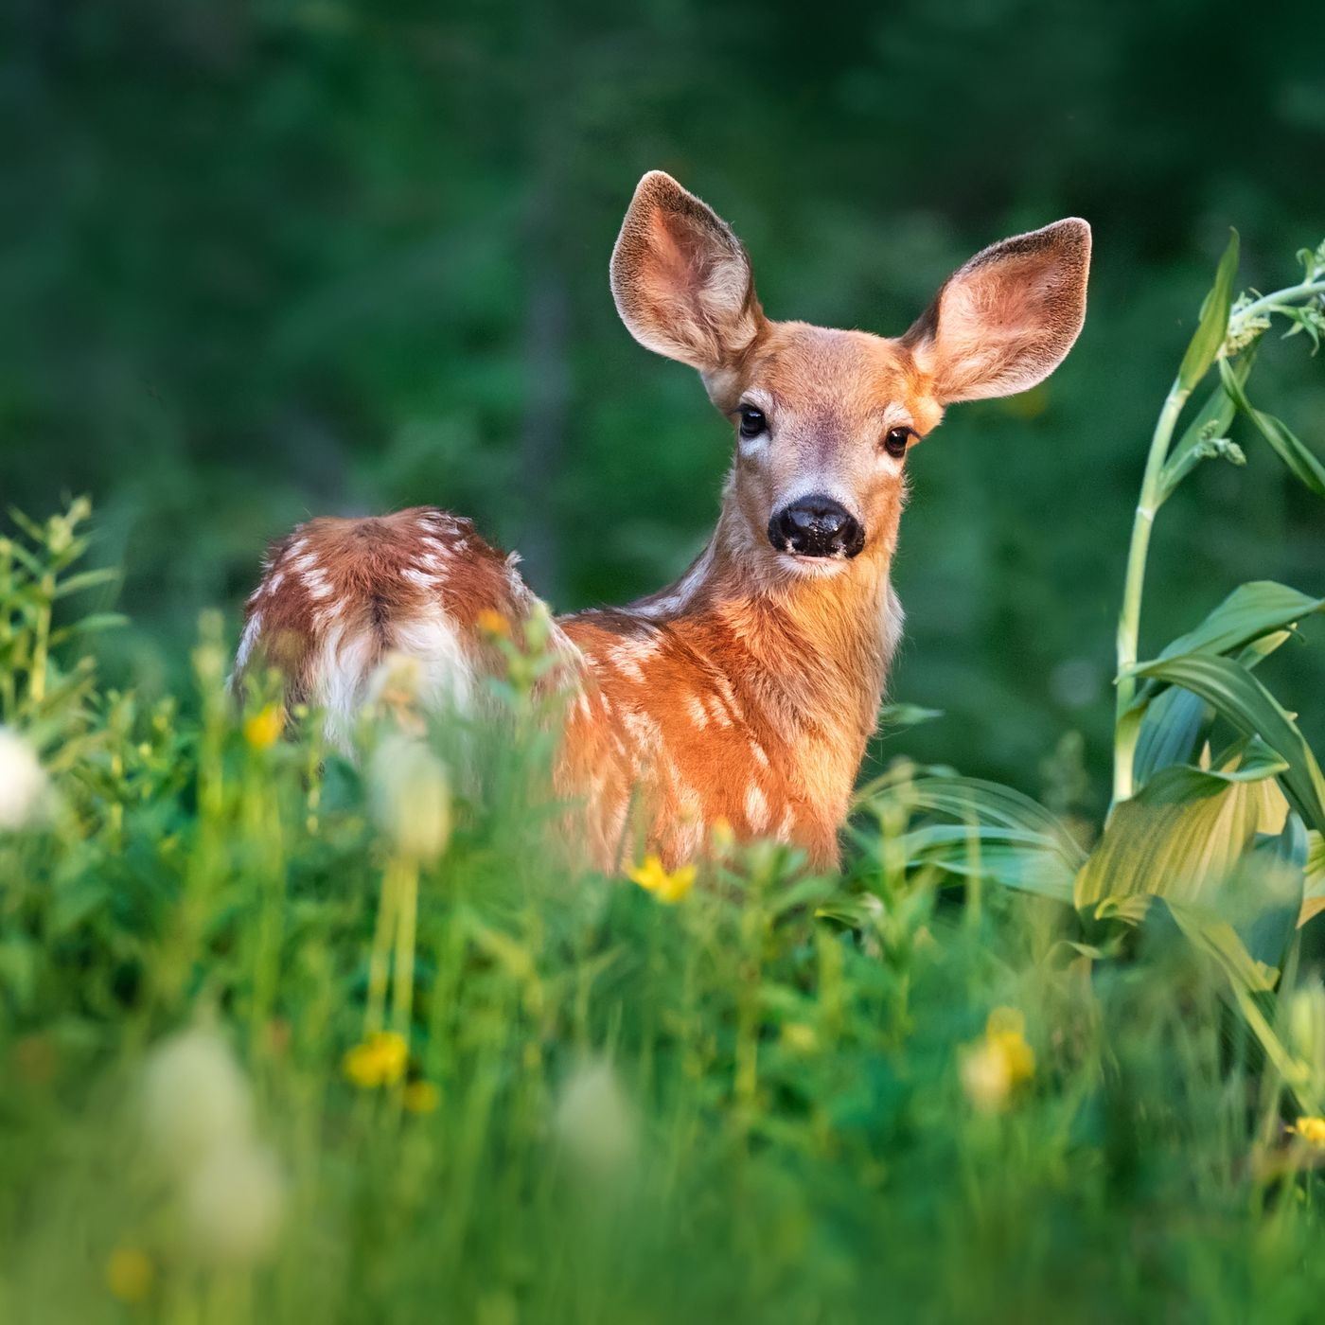
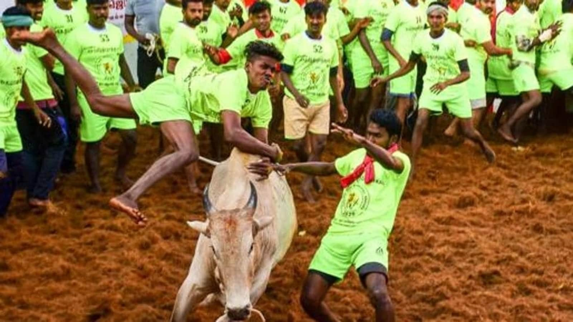
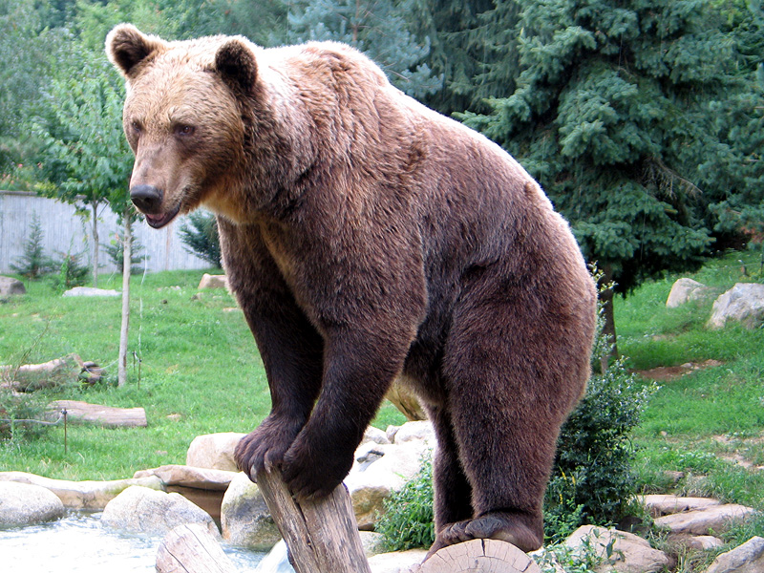
A pessimistic speculator is

Slide 136
WRONG CLICK

Slide 137
Good
Try Next One

Slide 138
Wrong
Try Again

Slide 139
An optimistic speculator is

Slide 140
WRONG CLICK

Slide 141
Good
Try Next One

Slide 142
Wrong
Try Again

Slide 143
Securities Exchange Board of India was first established in the year ____
1988
1992
1995
1998

Slide 144
WRONG CLICK

Slide 145
Good
Try Next One

Slide 146
Wrong
Try Again

Slide 147
The headquarters of SEBI is _______
Calcutta
Bombay
Chennai
Delhi

Slide 148
WRONG CLICK

Slide 149
Good
Try Next One

Slide 150
Wrong
Try Again

Slide 151
Registering and controlling the functioning of collective investment schemes as _______
Listing
Mutual Funds
Rematerialisation
Dematerialization

Slide 152
WRONG CLICK

Slide 153
Good
Try Next One

Slide 154
Wrong
Try Again

Slide 155
SEBI is empowered by the Finance ministry to nominate ______ members on the Governing body of every stock
exchange.
5
7
6
3

Slide 156
WRONG CLICK

Slide 157
Good
Try Next One

Slide 158
Wrong
Try Again

Slide 159
Trading is dematerialized shares commenced on the NSE is ________
January 1996
June 1998
December 1996
December 1998

Slide 160
WRONG CLICK

Slide 161
Good
Try Next One

Slide 162
Wrong
Try Again

Slide 163

Greetings to get More Marks
in I Midterm Exam

