Slide 1
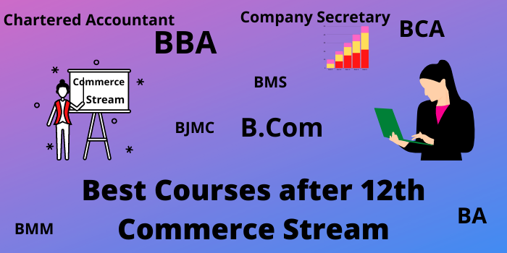
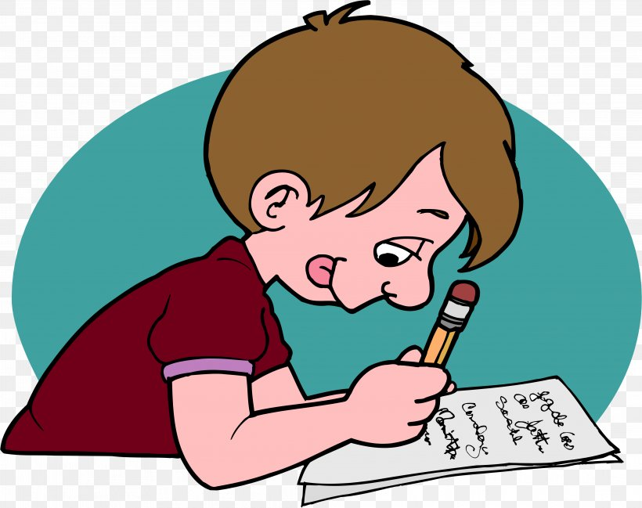
+ 1 Commerce
One Word Test

Slide 2

Prepared by ….
M.MuthuSelvam
M.Sc.,M.Com.M.Ed.,M.Phil.
PG Asst. in Commerce
MLWA HSS
(Run by Jain Educational & Empowerment Trust)
Madurai 625 001
Cell No: 98421 04826

Slide 3
In Pandiyas Dynasty the place where the goods are sold is ___
Market
Nalangadi
Angadi
Allangadi

Slide 4
WRONG CLICK

Slide 5

Good
Try Next One

Slide 6

Wrong
Try Again

Slide 7
Hindrance of place is removed by ______
Warehouse
Salesman
Transport
Insurance

Slide 8
WRONG CLICK

Slide 9
Good
Try Next One

Slide 10
Wrong
Try Again

Slide 11
Who wrote “Arthasasthra” ?
Kambar
Kautilya
Thiruvalluvr
Elangovadigal

Slide 12
WRONG CLICK

Slide 13
Good
Try Next One

Slide 14
Wrong
Try Again

Slide 15
Trade and Commerce was common to ______ Dynasty.
Pallava
Chola
Panidya
Chera

Slide 16
WRONG CLICK

Slide 17
Good
Try Next One

Slide 18
Wrong
Try Again

Slide 19
_______ was first sultan who paved way in the dense forest and helped traders to move from one market place to others place for their commercial caravans.
Vascoda Gama
Balban
Akbar
Alauddin Khilij

Slide 20
WRONG CLICK

Slide 21
Good
Try Next One

Slide 22
Wrong
Try Again

Slide 23
The Primary objective of a business is
Not Making Profit
Special skill
Making Profit
None of the above

Slide 24
WRONG CLICK

Slide 25
Good
Try Next One

Slide 26
Wrong
Try Again

Slide 27
Occupation of a Doctor is
Profession
Employment
Business
Sole Proprietor

Slide 28
WRONG CLICK

Slide 29
Good
Try Next One

Slide 30
Wrong
Try Again

Slide 31
The following does not characterize business activity?
Sale or exchange of goods and services
Production of goods and services
Presence of Risk
Salary or wages

Slide 32
WRONG CLICK

Slide 33
Good
Try Next One

Slide 34
Wrong
Try Again

Slide 35
Activities undertaken out of love and affection or with social service motive are termed as:
Economic activities
Monetary activities
Financial Activities
Non Economic Activities

Slide 36
WRONG CLICK

Slide 37
Good
Try Next One

Slide 38
Wrong
Try Again

Slide 39
The industries engaged in extraction of iron ore are known as
Construction Industries
Extraction Industries
Genetic Industries
Manufacturing Industries

Slide 40
WRONG CLICK

Slide 41
Good
Try Next One

Slide 42
Wrong
Try Again

Slide 43
Production which involves several stages for manufacturing finished products is known as
Processing Industry
Analytical Industry
Synthetic Industry
None of the above

Slide 44
WRONG CLICK

Slide 45
Good
Try Next One

Slide 46
Wrong
Try Again

Slide 47
Normally high level risk involved in
Commerce
Trade
Industry
All of the above

Slide 48
WRONG CLICK

Slide 49
Good
Try Next One

Slide 50
Wrong
Try Again

Slide 51
Which is the oldest form of Business organisation?
Partnership
Sole Proprietorship
Company
Co-operative Society

Slide 52
WRONG CLICK

Slide 53
Good
Try Next One

Slide 54
Wrong
Try Again

Slide 55
In which form the owner, establisher and manager is only one?
Sole Proprietor
Joint Enterprise
Government Company
Co-operative Society

Slide 56
WRONG CLICK

Slide 57
Good
Try Next One

Slide 58
Wrong
Try Again

Slide 59
A major disadvantage of sole proprietor-ship is ______
Unlimited liability
Limited liability
Easy Formation
Quick decision

Slide 60
WRONG CLICK

Slide 61
Good
Try Next One

Slide 62
Wrong
Try Again

Slide 63
From the following which one is Non- corporate form of business?
Sole trading business
Joint stock company
Co-operatives
Government company

Slide 64
WRONG CLICK

Slide 65
Good
Try Next One

Slide 66
Wrong
Try Again

Slide 67
The firm of Hindu Undivided Family is managed by whom?
Owner
Karta
Manager
Partner

Slide 68
WRONG CLICK

Slide 69
Good
Try Next One

Slide 70
Wrong
Try Again

Slide 71
In the firm of Hindu Undivided Family, how one gets the membership?
By Agreement
By
Birth
By Investing Capital
By Managing

Slide 72
WRONG CLICK

Slide 73
Good
Try Next One

Slide 74
Wrong
Try Again

Slide 75
The members in the joint hindu family are called _____
Karta
generations
coparceners
partners

Slide 76
WRONG CLICK

Slide 77
Good
Try Next One

Slide 78
Wrong
Try Again

Slide 79
‘Only the male members in the family get the right of inheritance by birth’ as ________
Mitakshara Law
Hindu law
Dayabhaga law
None of these

Slide 80
WRONG CLICK

Slide 81
Good
Try Next One

Slide 82
Wrong
Try Again

Slide 83
A partnership is formed by ____
the direction of government
relationship among persons
agreement
Friendship

Slide 84
WRONG CLICK

Slide 85
Good
Try Next One

Slide 86
Wrong
Try Again

Slide 87
The relationship between outsiders and the company is defined in ______
Memorandum of Association
Articles of Association
Prospectus
Certificate of Incorporation

Slide 88
WRONG CLICK

Slide 89
Good
Try Next One

Slide 90
Wrong
Try Again

Slide 91
Table A of the Companies Act is a ______
Model minutes book
Model of AOA
Model form of Balance Sheet
Model of MOA

Slide 92
WRONG CLICK

Slide 93
Good
Try Next One

Slide 94
Wrong
Try Again

Slide 95
Which of the following is created by a Special Act of Parliament or in State Assemblies?
Chartered company
Foreign company
Statutory company
Government company

Slide 96
WRONG CLICK

Slide 97
Good
Try Next One

Slide 98
Wrong
Try Again

Slide 99
The Board of directors of a company is elected by ____
Creditors
Share holders (members)
Debtors
Debenture holders

Slide 100
WRONG CLICK

Slide 101
Good
Try Next ONe

Slide 102
Wrong
Try Again

Slide 103
Companies established as a result of a charter granted by the King or Queen of a country is called _________
Foreign companies
Registered companies
Statutory companies
Chartered companies

Slide 104
WRONG CLICK

Slide 105
Good
Try Next One

Slide 106
Wrong
Try Again

Slide 107
Membership in a cooperative organization is:
Not open to all
Open to all
Selective
None of them

Slide 108
WRONG CLICK

Slide 109
Good
Try Next One

Slide 110
Wrong
Try Again

Slide 111
Cooperative fails because of
Mismanagement
Unlimited membership
Cash trading
Loss-making

Slide 112
WRONG CLICK

Slide 113
Good
Try Next One

Slide 114
Wrong
Try Again

Slide 115
All cooperatives are established with
Service motive
Reform motive
Profit motive
Philanthropic motive

Slide 116
WRONG CLICK

Slide 117
Good
Try Next One

Slide 118
Wrong
Try Again

Slide 119
Consumers Co-operation was first successful in _____
India
England
Swiss
USA

Slide 120
WRONG CLICK

Slide 121
Good
Try Next One

Slide 122
Wrong
Try Again

Slide 123
Rochdale society of equitable pioneers was started by ____
Robert owen
H.C.Calvert
Talmaki
Lambert

Slide 124
WRONG CLICK

Slide 125
Good
Try Next One

Slide 126
Wrong
Try Again

Slide 127
A Multinational Corporation can be defined as a firm which
owns companies in more than one
country
is beyond the control of any government
is one of the top 200 firms in the world
All the above

Slide 128
WRONG CLICK

Slide 129
Good
Try Next One

Slide 130
Wrong
Try Again

Slide 131
Centralised control in MNC’s implies control exercised by
Branches
Subsidiaries
Headquarters
Parliament

Slide 132
WRONG CLICK

Slide 133
Good
Try Next One

Slide 134
Wrong
Try Again

Slide 135
Enterprises operating in several countries but managed from one country is termed as ___________
Government company
Multinational Company
Joint Venture
Private company

Slide 136
WRONG CLICK

Slide 137
Good
Try Next One

Slide 138
Wrong
Try Again

Slide 139
Dispersal of decision making power to branches / affiliates / subsidiaries by head office represents _________
Decentralisation
Centralisation
Power
Integration

Slide 140
WRONG CLICK

Slide 141
Good
Try Next One

Slide 142
Wrong
Try Again

Slide 143
Coca-Cola company is an example of ____
Public company
MNC
Joint Venture
Government company

Slide 144
WRONG CLICK

Slide 145
Good
Try Next One

Slide 146
Wrong
Try Again

Slide 147
The share capital of the government company must not be less than
75 %
51 %
60 %
95 %
,

Slide 148
WRONG CLICK

Slide 149
Good
Try Next One

Slide 150
Wrong
Try Again

Slide 151
The oldest form of organisation in public sector
Public Sector Undertakings
Departmental Undertakings
Multi National Corportions
Statutory Corportion

Slide 152
WRONG CLICK

Slide 153
Good
Try Next One

Slide 154
Wrong
Try Again

Slide 155
A Government company purchases shares in the name of
Chief Justice of India
President
Prime Minister
State Chief Minister

Slide 156
WRONG CLICK

Slide 157
Good
Try Next One

Slide 158
Wrong
Try Again

Slide 159
The primary objective of the state enterprises is to ______
Serve the People
Earn profit
Provide Employment
All the Above

Slide 160
WRONG CLICK

Slide 161
Good
Try Next One

Slide 162
Wrong
Try Again

Slide 163
Which bank has the power to issue bank notes?
Commercial bank
Central bank
Foreign banks
Co-operative banks

Slide 164
WRONG CLICK

Slide 165
Good
Try Next One

Slide 166
Wrong
Try Again

Slide 167
The Central bank of India is
RBI
PNB
SBI
ICICI

Slide 168
WRONG CLICK

Slide 169
Good
Try Next One

Slide 170
Wrong
Try Again

Slide 171
The Reserve Bank of India commenced its operations from April 1,
1936
1934
1935
1933

Slide 172
WRONG CLICK

Slide 173
Good
Try Next One

Slide 174
Wrong
Try Again

Slide 175
Bankers are not only dealers of money but also leaders in
Service development
Trade development
Industry development
Economic development

Slide 176
WRONG CLICK

Slide 177
Good
Try Next One

Slide 178
Wrong
Try Again

Slide 179
Which of the following is not a function of a central bank?
Guiding and regulating the banking
system of a country
Deal with the general public
Acts essentially as Government
banker
Maintains deposit accounts of all
other banks

Slide 180
WRONG CLICK

Slide 181
Good
Try Next One

Slide 182
Wrong
Try Again

Slide 183

Greetings to get More Marks

